Slide 1
Employee Management System
Presentation by: Bery Orindi
Notes:
How EMS developed
EMS Feature
Why should use this
Lesson learn from this developing

Slide 2
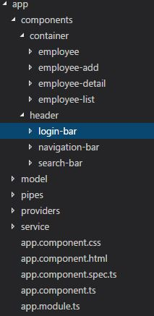
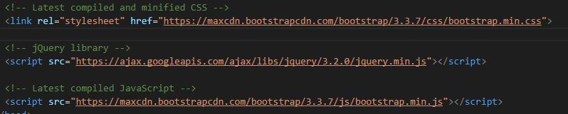
Front End / Client
  Angular 2
        Bootstrap

Slide 3
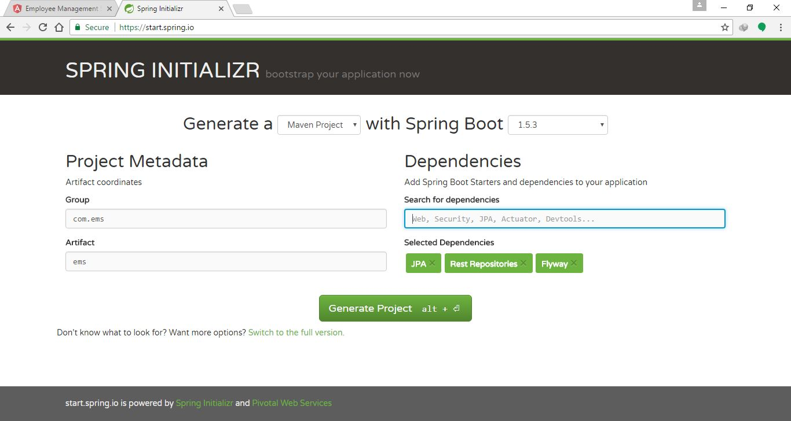
Back End / Server
  Spring

Slide 4

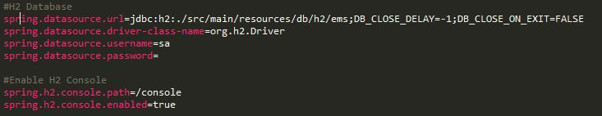
Back End / Server
  H2 Database

Slide 5
EMS Feature

Slide 6
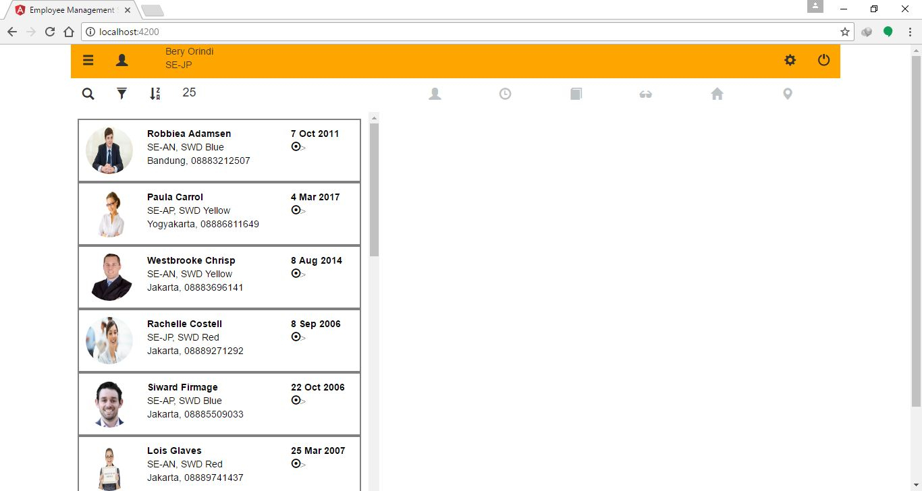
Home page

Slide 7
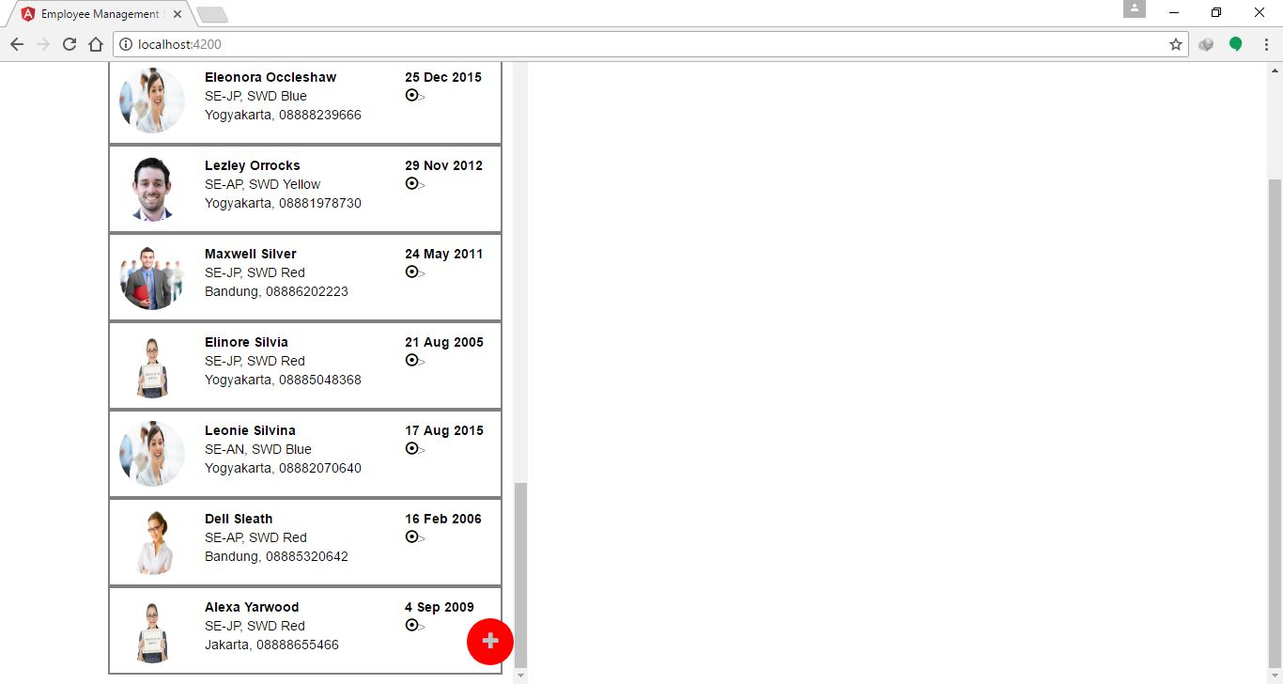
Home page

Slide 8
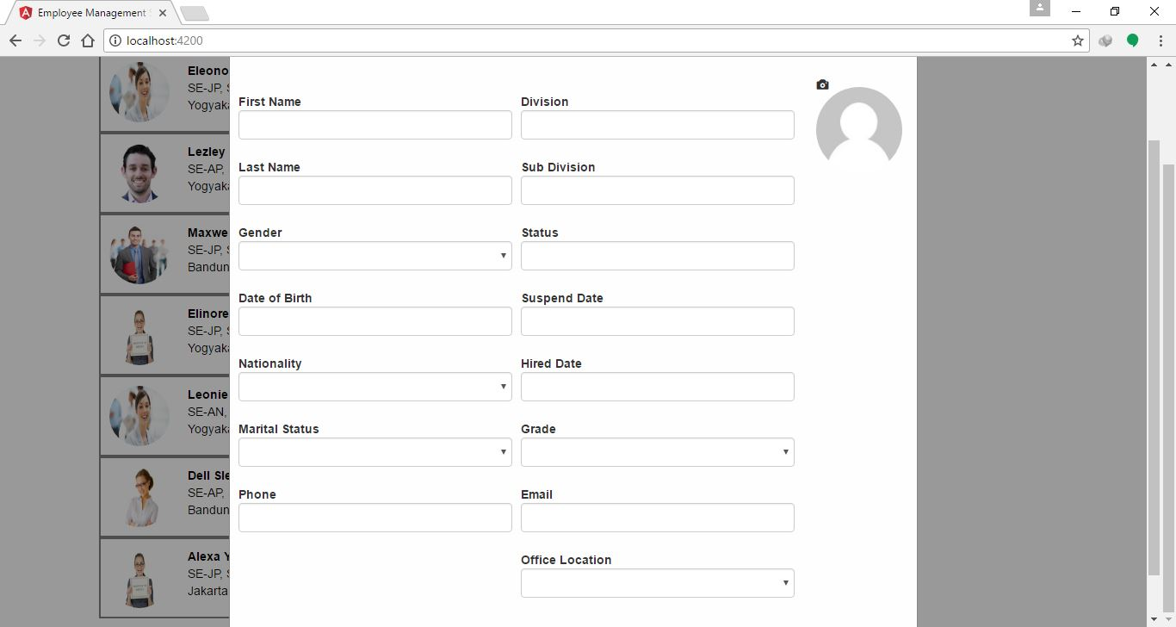
Add employee

Slide 9
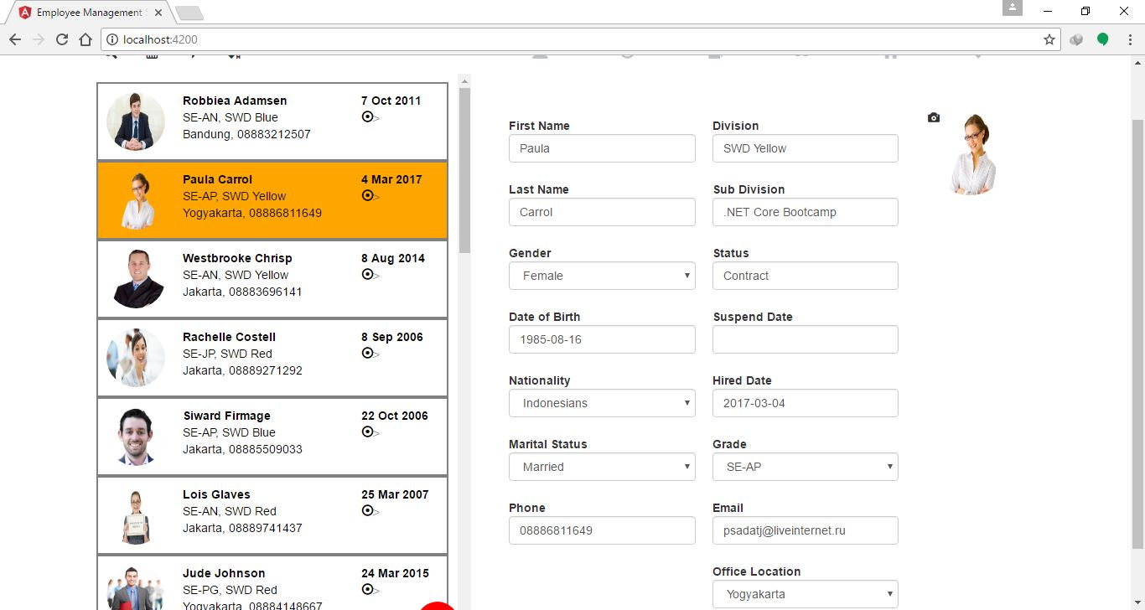
Detail Employee

Slide 10
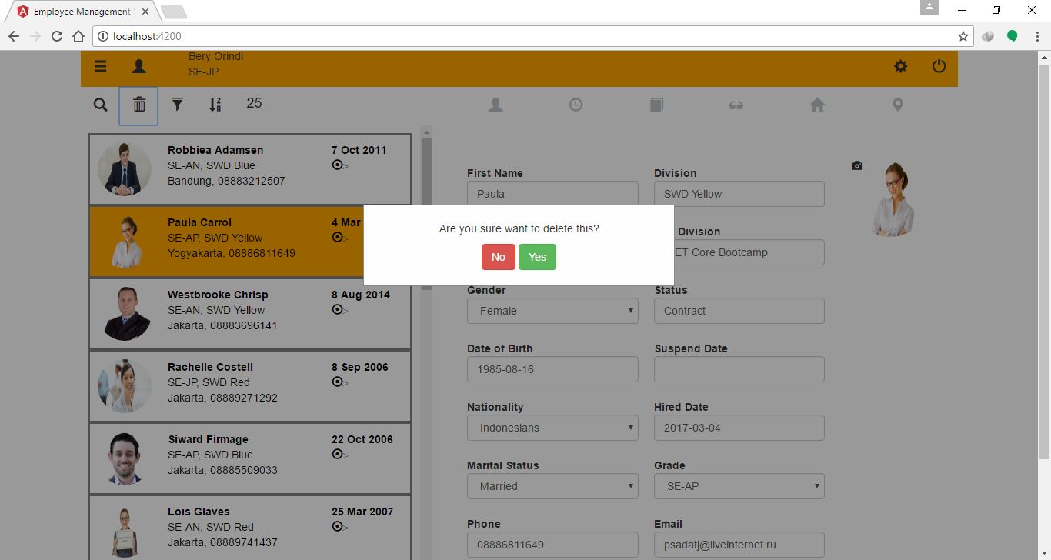
Delete Employee

Slide 11
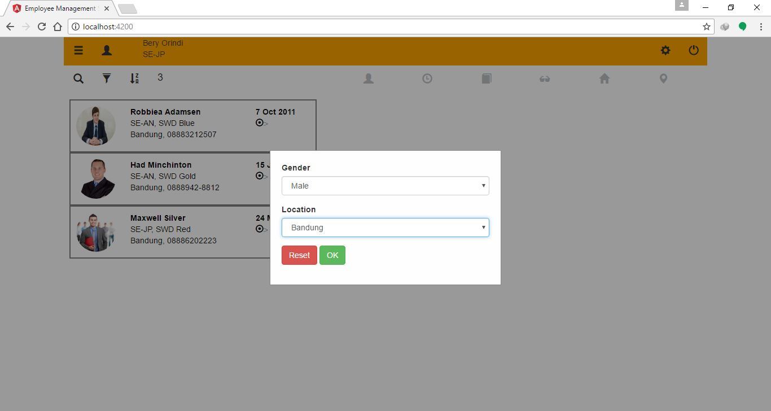
Filter by gender and location

Slide 12
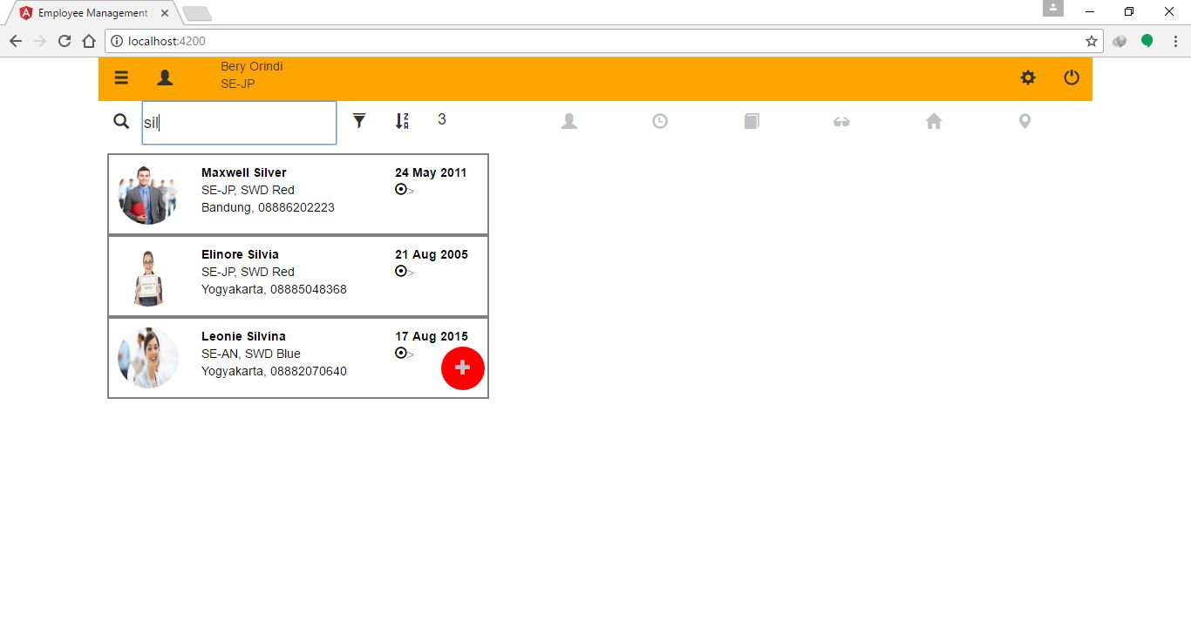
Search by last name

Slide 13
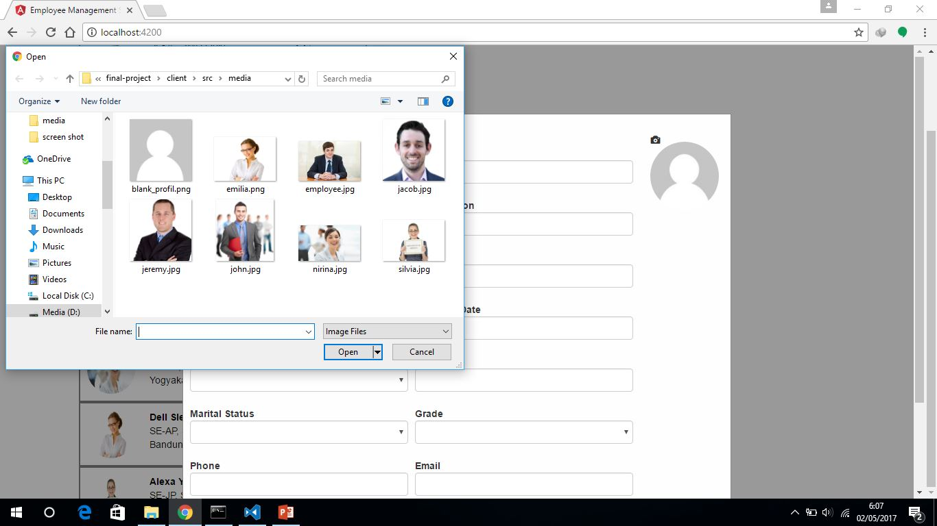
Upload Picture

Slide 14
Why should use this
EMS using flyaway
Filter, sort, search in front end

Slide 15
Thank You

